Slide 1
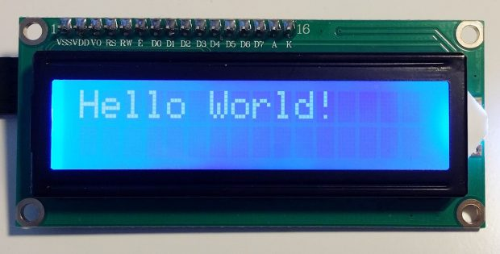
Interfacing LCD with beagle bone black
Submitted by:
Karamjot kaur (c0754576)

Slide 2
Agenda
Introduction
List of Components
Application in Project
Ultrasonic Sensor
LCD
Buzzer
Connections in Schematic Diagram
Beagle Bone Black and its pins used
Supporting Software
Connections
Results
Conclusions
References

Slide 3
Introduction
In this presentation, the interfacing of LCD with ultrasonic sensor has been explained.
Here, ultrasonic sensors and a buzzer are used to complete the interfacing.
We are using LCD with inbuilt PCF8574 and Beagle Bone Black as a main MCU in the project.
The connections are made on the breadboard using jumper wires.
The upcoming slides are going to explain the application of these components in project, its connections and the software used to complete this interfacing.

Slide 4
List of components
Following components are used in this interfacing:
LCD with PCF8574
Ultrasonic Sensors
Buzzer
Beagle Bone Black
Breadboard
Jumper wires
External Power Adaptor

Slide 5
Application in project
In IoT based visitor counter project, LCD is used to display the count of customers present in the store.
The maximum limit for customers allowed in store has been set. When the limit reached, the gates will close, and the next customer is not allowed to enter in the store.
The next entry is permitted once one customer exits and the count decreases.
The presence of the customer has been detected by ultrasonic sensors that are installed at the entry and the exit gate of store.
Also, buzzer will ring when a maximum count reached, and a new customer comes to the door.

Slide 6
Communication Protocol
In this interfacing, I2C interfacing is used as communication protocol for LCD.
Ultrasonic sensors and Buzzer are connected using GPIO pins of Beagle Bone Black.
I2C is a multi-master synchronous serial communication protocol for devices. All devices have addresses through which they communicate with each other.
The I2C protocol has a bus arbitration procedure through which the master is decided on the bus, and then the master supplies the clock for the system and reads and writes data on the bus.
The device that is communicating with the master is the slave device.
Here, #include <linux/i2c-dev.h> header file is used for I2C library.

Slide 7
Ultrasonic sensor
Here, an ultrasonic sensor module HC - SR04 is used.
It provides 2cm - 400cm non-contact measurement function, and its accuracy can reach to 3mm.
The modules includes ultrasonic transmitters, receiver and control circuit.
The basic principle of work:
(1) Using IO trigger for at least 10us high level signal
(2) The Module automatically sends eight 40 kHz and detect whether there
is a pulse signal back.
(3) If the signal back, through high level, time of high output IO duration
is the time from sending ultrasonic to returning.
Test distance = (high level time×velocity of sound (340M/S) / 2.
This sensor has additional control circuitry that can prevent inconsistent "bouncy" data depending on the application.

Slide 8
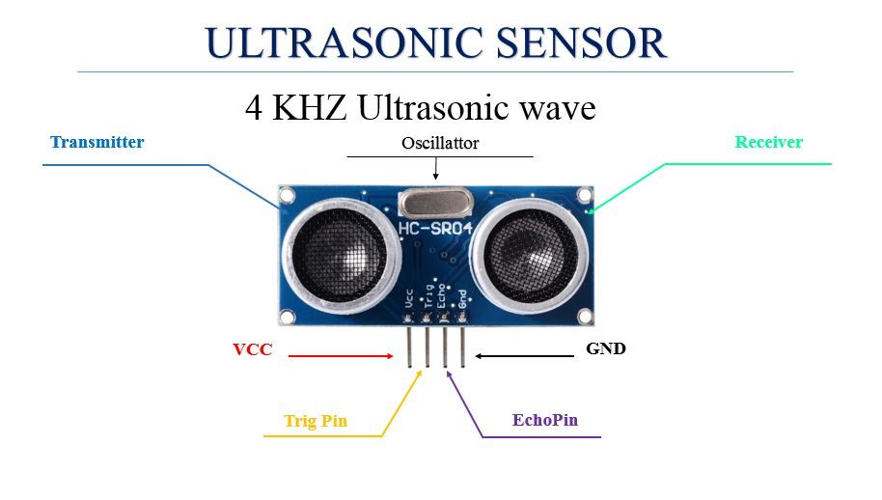

Slide 9
Ultrasonic Sensor’s working
There are two ultrasonic sensors used for both entry and exit.
Both the sensors continuously measure distance of obstacles in front of them.
Range of ultrasonic sensor is set for 20 cm.
If a person comes inside range of sensor 1 it will be counted as person entered inside.
If a person comes inside range of to sensor 2 it will be counted as person exit.
A limit of 10 person is set, if already 10 persons are inside other person must wait outside until someone exit.

Slide 10
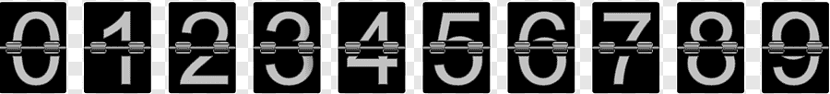
Lcd
In this project, LCD with inbuilt PCF8574 is used.
It is dot matrix LCD of 2-dimensional patterned array to display the characters, symbols and numeric.
When a customer is detected by an ultrasonic sensor at the entry and the exit gate of a store, then the count of the customers present in a store is displayed on the screen.
A limit of 10 people has been set for the project.
After 10 counts, when a next customer arrives, “Max count reach” message will be displayed on the screen.

Slide 11
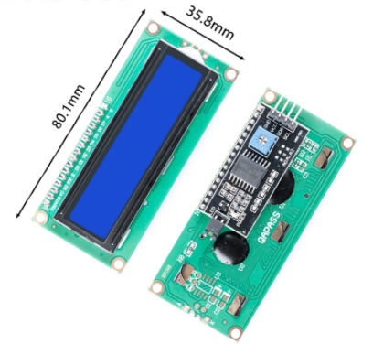
Features of LCD
Easy to use. Less I/O ports are occupied
Support the I2C protocol. The I2C LCD1602 library is provided. The I2C tools package is installed in the BBB to support the LCD.
With a potentiometer used to adjust backlight and contrast.
Power supply: +5V.
Address of the module: 0x27.

Slide 12
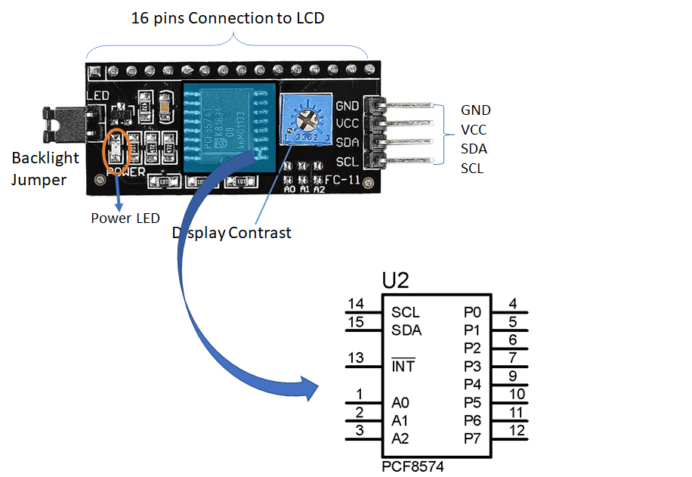
PIN configuration of lcd with pcf8574
In built PCF8574 coverts the 16 pins to 4 pins to communicate with the BBB
VCC
GND
SDA( Serial Data)
SCL(Serial Clock)

Slide 13
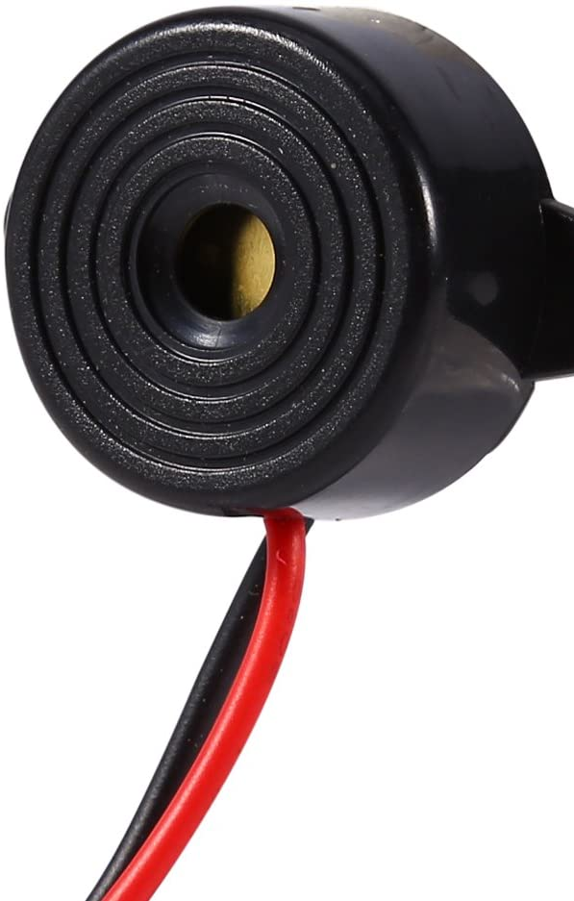
buzzer
Piezo buzzer is a simple devices that can generate basic beeps and tones.
It works by using a piezo crystal, a special material that changes shape when voltage is applied to it.
If the crystal pushes against a diaphragm, like a tiny speaker cone, it can generate a pressure wave which the human ear picks up as sound.
In this project, there is a digital communication between a buzzer and a Beaglebone Black using GPIO pins of Beaglebone Black.
Positive pins of buzzer is connected to the GPIO pin and negative is connected to the DGND of Beaglebone Black.
Initially, define the GPIO pin for buzzer and set it as an output pin.

Slide 14
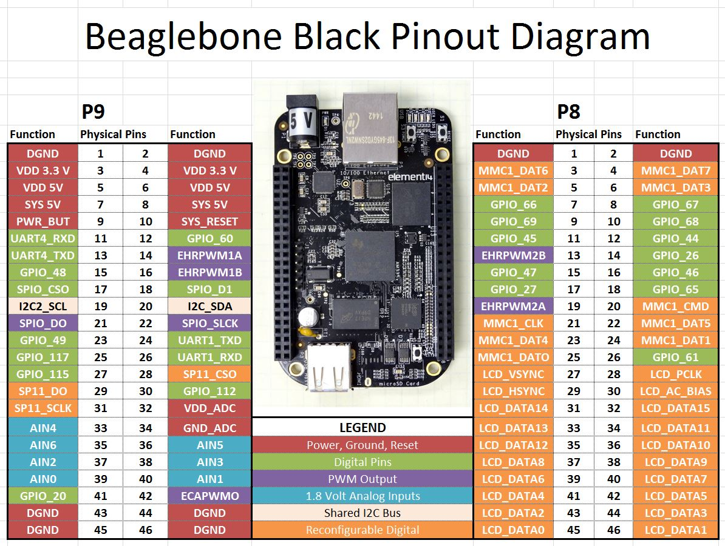
LCD Connections:
Vcc- Pin 7 (Port 9)
GND- Pin 1 (Port 9)
SCL- Pin 19 (Port 9)
SDA- Pin 20 (Port 9)
Buzzer:
Positive- Pin 23 (Port 9)
Negative- Pin 46 (Port 9)
Ultrasonic sensor1:
Trig- Pin 8 (Port 8)
Echo- Pin 10 (Port 8)
Vcc- Pin 5 (Port 9)
GND- Pin 1 (Port 8)
Ultrasonic sensor2:
Trig- Pin 12 (Port 8)
Echo- Pin 14 (Port 8)
Vcc- Pin 6 (Port 9)
GND- Pin 2 (Port 8)

Slide 15
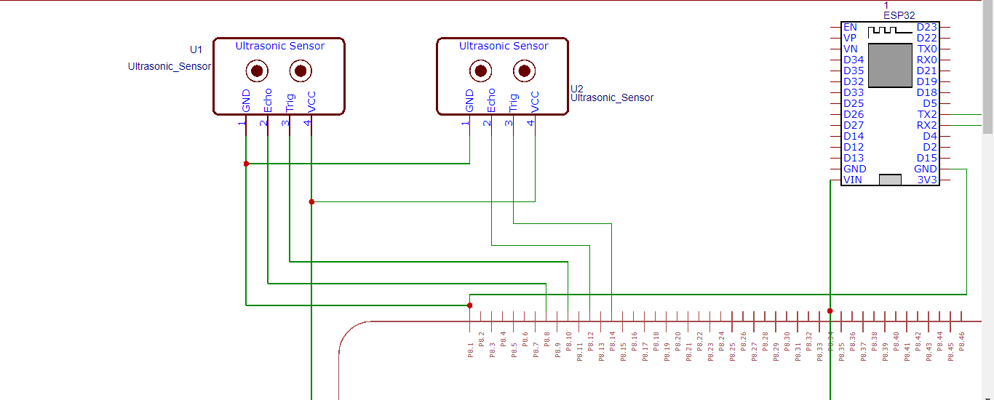
Connections in schematic diagram
Connections of ultrasonic sensors with Beagle Bone Black.

Slide 16
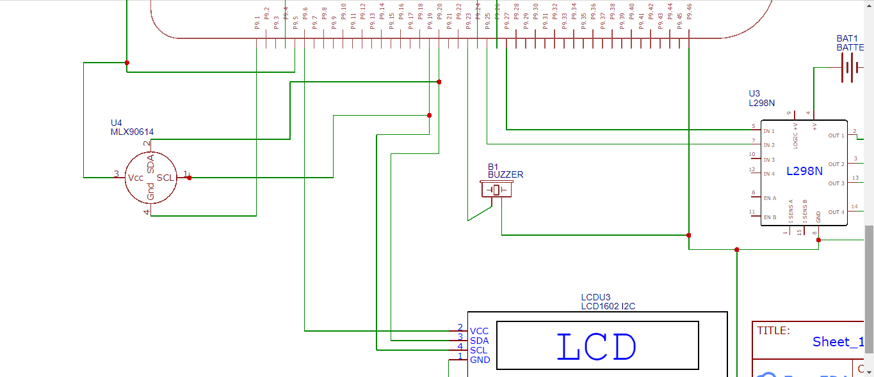
Connections in schematic diagram
Connections of LCD and Buzzer with Beagle Bone Black.

Slide 17
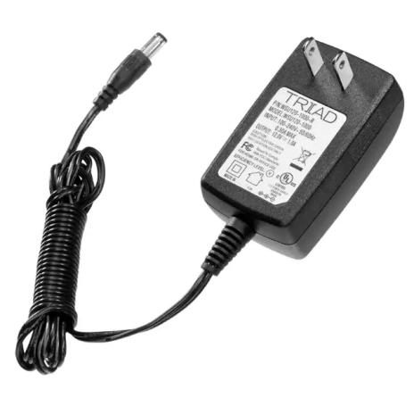
Power adapter
The power Adapter is used for the power supply of 5V to Beaglebone Black
Electrical specifications
Input voltage range – 90-264V
Output voltage – 5v
Average efficiency - >78.70%
Output current – 2A

Slide 18
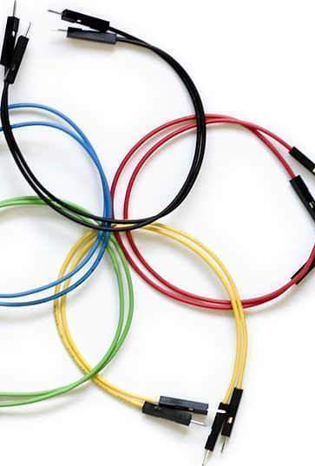
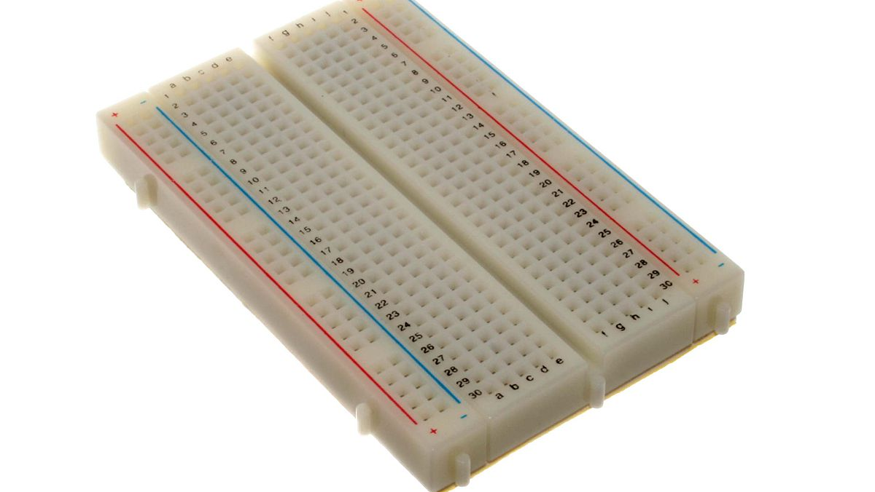
Jumper wires and Breadboard
Breadboard and jumper wires are used to make connections between components and Beagle Bone Black.

Slide 19
Supporting softwares
The programming of this interfacing is in C language. Here, Eclipse IDE is used to write the codes.
PuTTY is an SSH and telnet client, and it is an open-source software that is compatible with Microsoft Windows.
WinSCP (Windows Secure Copy) is a free and open-source SFTP, FTP, WebDAV, Amazon S3 and SCP client for Microsoft Windows. It is used for a secure file transfer between a local and a remote computer.
To define pins in BBB we need to install iobb library.
mkdir development
cd development
git clone https://github.com/shabaz123/iobb.git
cd iobb
Make
Make install

Slide 20
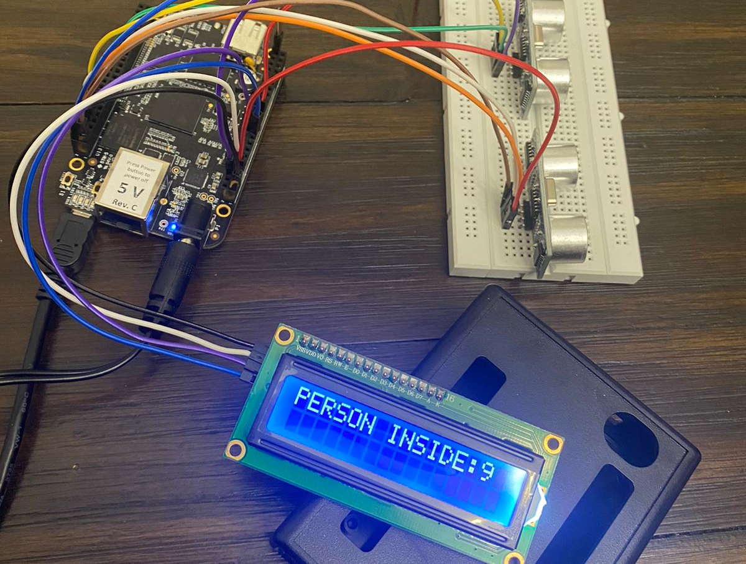
connections

Slide 21
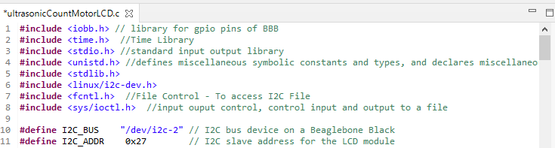
The stdio.h header defines the variables type, several macros and functions to perform input and output operations
The stdlib.h defines the macros (NULL, EXIT_Failure etc.) and functions to perform general functions(malloc,calloc)
Unistd library for usleep
I2c-dev Library to interface with I2c Devices
Fcntl.h defines in C programming language refer to control file i.e opening, closing vice versa.
Ioctl is input output control. It controls input and output to file.

Slide 22
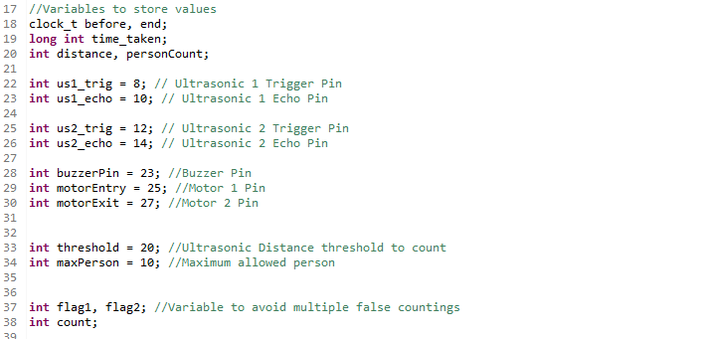
Here, the pins are initialized as the trigger pin and echo pin of both the sensors are initialized.
Then the 23 pin of port 8 has been initialized along with setting the limit and the distance threshold as 10 and 20cm, respectively.

Slide 23
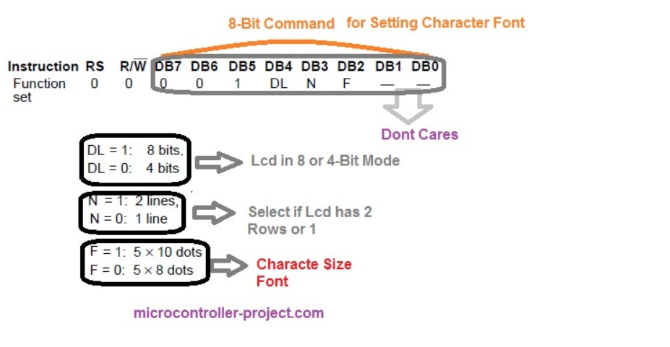
LCD Initialization Bits
D7: Data bit
D6: Data bit
D5: 1 for Initialization of 8- and 4-bit mode
D4: LCD mode: 1: 8bits
0: 4-bits
BL: Backlight
Enable -1 or 0
RW: 1: Read data
0: Write data
RS: 0: Command register
1: Data Register

Slide 24
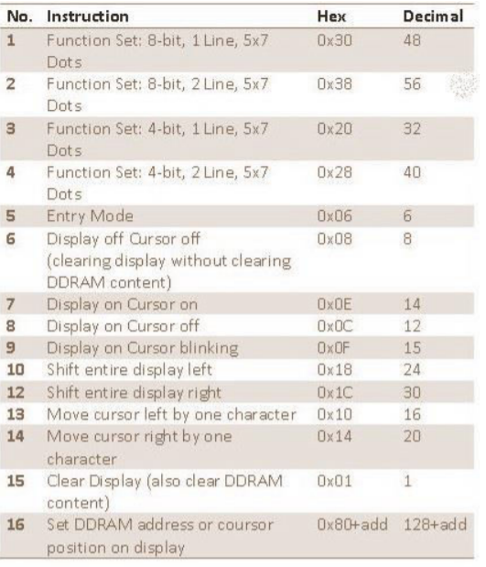
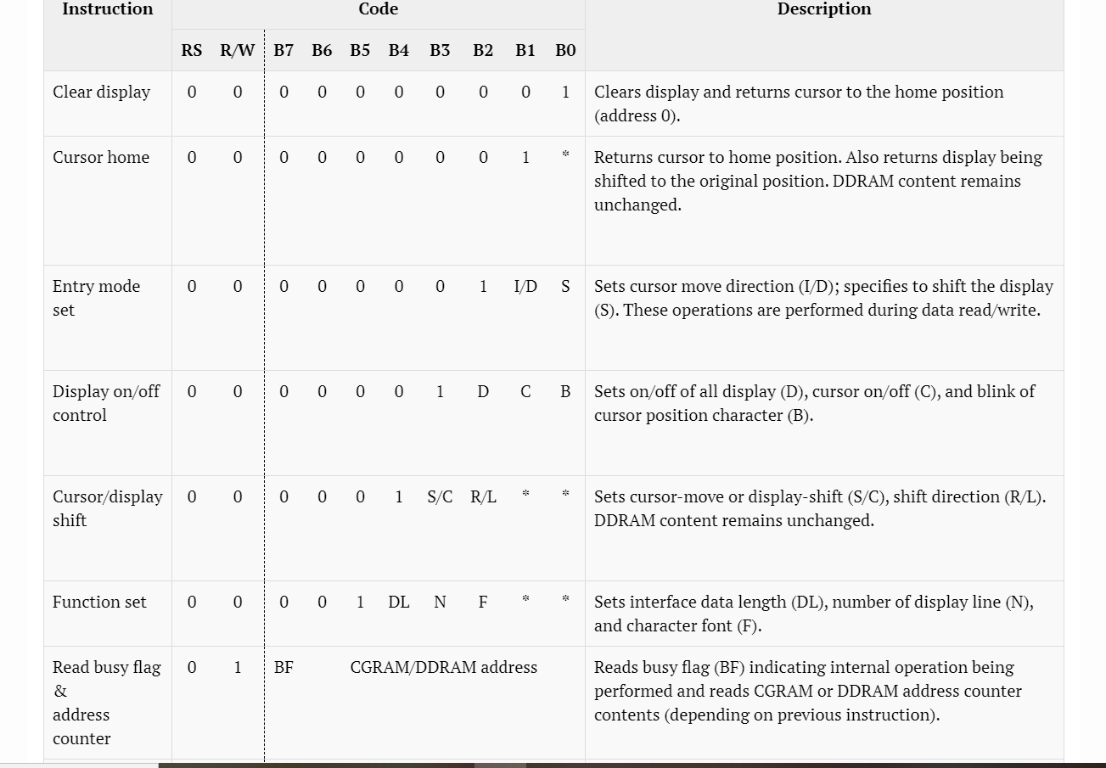

Slide 25
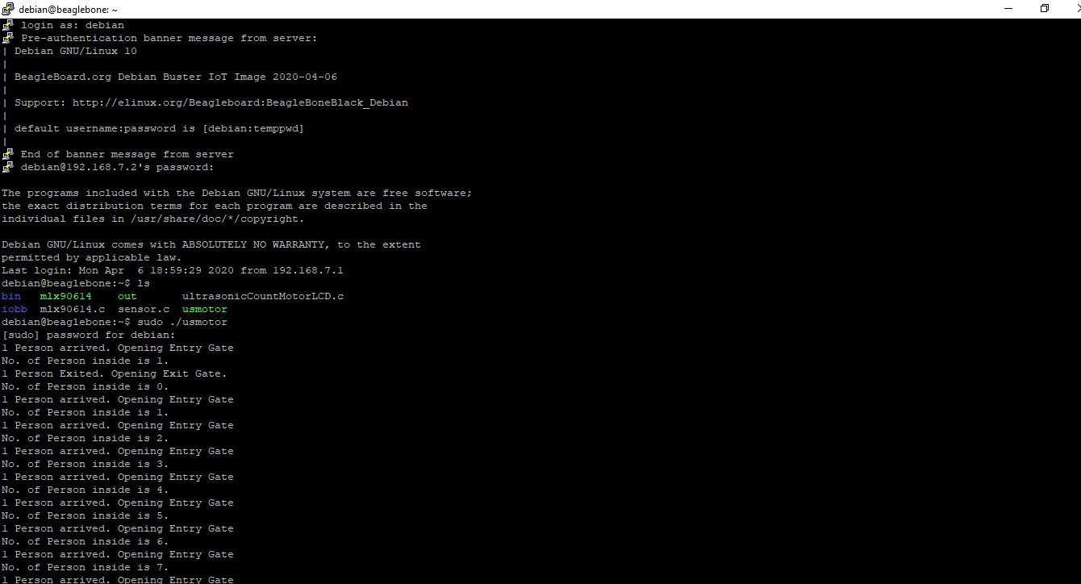
After logging in to Putty, “ls” command is used to check the list of files in Beagle Bone Black.
Once the compilation is completed, “./usmotor” command is used to run the code for output.
us 1 senses customers at entry and us2 senses customers at exit.
As customer enters the store the count increases and it decreases as a customer exits the store.
Maximum limit of 10 customer is set.
After reaching this limit, no more customers will be allowed to enter.

Slide 26
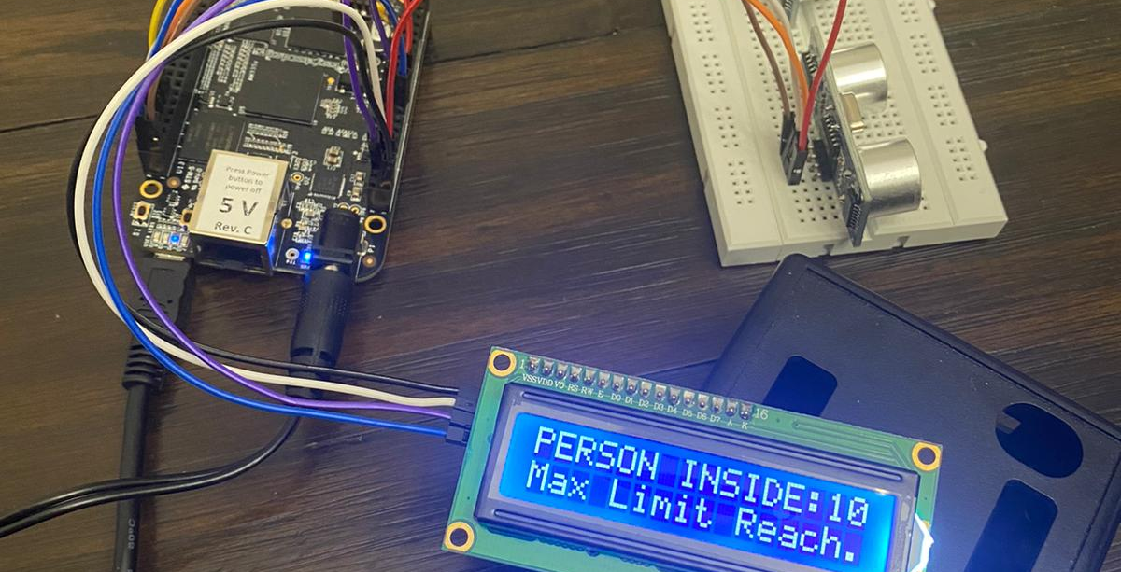

Slide 27
conclusion
Here, we completed the interfacing of LCD with Beagle Bone Black.
The interfacing is successful, and we are displaying the number of customer on the screen.
The sensors are detecting the presence of customers perfectly and the buzzer rings after reaching the maximum limit.
However, I faced some issues such as the jumper wires were loose which were resulting in false detection by the sensor, but after securing them properly the circuit works fine.

Slide 28
references
Fm4dd. (2018, February 2). pcf8574-lcd-demo.c. Git hub. Retrieved from: https://github.com/fm4dd/i2c-lcd/blob/master/pcf8574-lcd-demo.c
Garage, E. (2019, June 17). How to display 5×8 and 5×10 size font characters on 16×2 lcd with 8-bit microcontrollers. Engineers Garage. Retrieved from: https://www.engineersgarage.com/pic-microcontroller/5x10-size-font-characters-displayed-on-16x2-lcd/
Garage, E. (2019, September 17). NxN(8×1 , 8×2 , 10×2 , 16×1 , 16×2 , 16×4 , 20×2 , 20×4 ,24×2 , 30×2 , 32×2 , 40×2) Character lcd working, Pinout and description. Engineers Garage. Retrieved from: https://www.engineersgarage.com/knowledge_share/16x2-lcd-working/
Header Files. (N.D.). Pja.edu. Retrieved from: https://users.pja.edu.pl/~jms/qnx/help/watcom/clibref/headers.html
Interfacing with I2C Devices. (N.D.). Elinux.org. Retrieved from: https://elinux.org/Interfacing_with_I2C_Devices
LCD 16 x 2 Basics. (N.D.). Explore embedded. Retrieved from: https://www.exploreembedded.com/wiki/LCD_16_x_2_Basics

Slide 29
LCD Initialization. (N.D.). Alfredstate.edu. Retrieved from: http://web.alfredstate.edu/faculty/weimandn/lcd/lcd_initialization/lcd_initialization_index.html
Linux C programming - the difference between fcntl, ioctl and stat. (N.D.). ProgrammerSought. Retrieved from: https://programmersought.com/article/93751447289/
PuTTY. (n.d.). Retrieved from Wikipedia, the free encyclopedia. Retrieved from: https://en.wikipedia.org/wiki/PuTTY
WinSCP Review and Download. (n.d.). Retrieved from ssh.com. Retrieved from: https://www.ssh.com/ssh/winscp/
https://github.com/shabaz123/iobb
shabaz. (2019, august 14). Beaglebone Black (BBB) and pocketbeagle I/O (GPIO), SPI, and I2C library for C - 2019 edition. element 14. Retrieved from : https://www.element14.com/community/community/designcenter/single-board-computers/next-genbeaglebone/blog/2019/08/15/beaglebone-black-bbb-io-gpio-spi-and-i2c-library-for-c-2019-edition
https://cdn.sparkfun.com/datasheets/Sensors/Proximity/HCSR04.pdf

Slide 30

Thank you

